Slide 1




Video Recoloring via Spatial-Temporal Geometric Palettes
Zheng-Jun Du Tsinghua University, Qinghai University
Kai-Xiang Lei Tsinghua University
Kun Xu Tsinghua University
Jianchao Tan Kwai Inc.
Yotam Gingold George Mason University
Notes:
Hello everyone, I am Zhengjun Du from Tsinghua University. In this talk, I will introduce a spatial-temporal geometry-based approach to video recoloring.

Slide 2
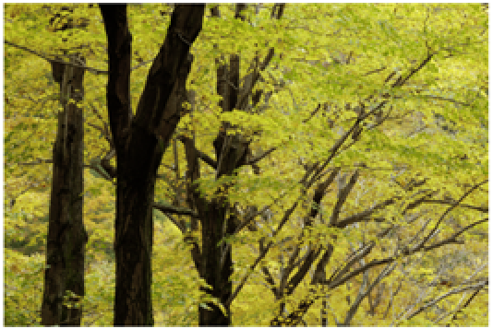
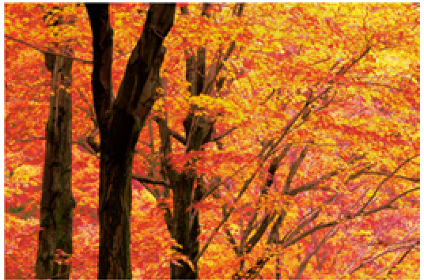
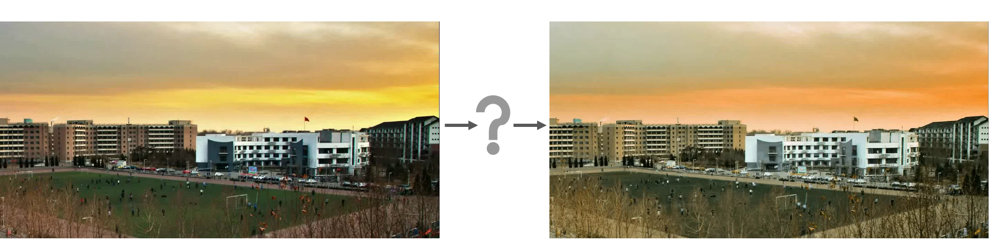
Motivation
Palette-based image recoloring is intuitive and simple
image
palette
edited palette
recolored image
Can we extend it to recolor a video?
Input video
Palette
Recolored video
Challenge: The palette can change over time!
Notes:
Palette-based image editing is a recent paradigm for color adjustment. These approaches extract a palette with several salient colors from the image to represent the color distribution. The palette provides users with an intuitive set of handles to edit the image. And users can easily recolor the image by modifying its palette colors.
The natural idea is that can we extend the palette-based image recoloring to video editing?
The key challenge is that the palette should capture color changes in the video, so the user can edit them. The palette should also allow the user to introduce color changes over time.

Slide 3
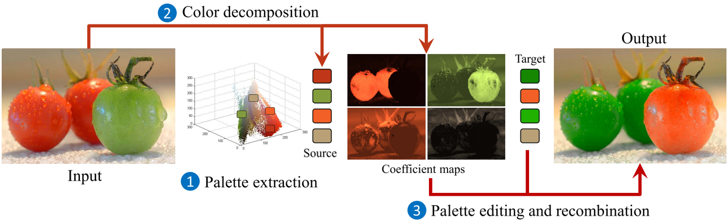
Related work
Clustering-based methods
  [Chang et al. 2015; Nguyen et al. 2017; Zheng et al. 2017]
Palette-based image recoloring using color decomposition optimization [Zheng et al. 2017]
Notes:
As for palette-based image recoloring, there are two main kinds of approaches.
The first is based on clustering, these methods employ k-means clustering of pixels to extract palette colors, these palettes capture the dominant colors in an image. And then decompose pixel into linear combination with the palette, which enables efficient image recoloring.

Slide 4
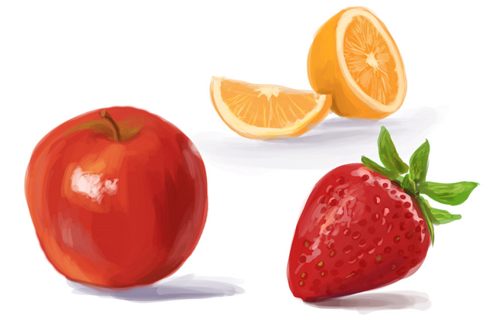
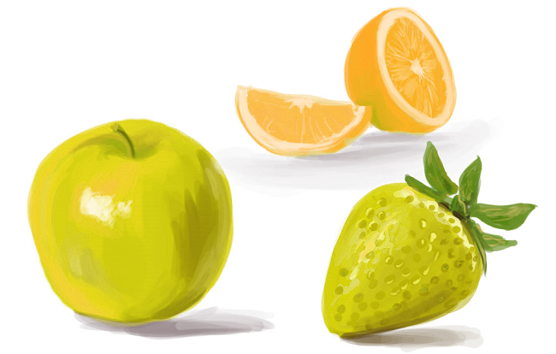

Related work
Convex hull-based methods
  [Tan et al. 2017; Tan et al. 2018; Wang et al. 2019]
RGB image I
Palette(convex hull)
Recolored image
An improved geometric approach for palette-based image decomposition and recoloring [Wang et al. 2019]
Notes:
The second is based on convex hull. These methods extract palettes from images based on simplified RGB convex hulls. The simplified convex hull has a simple geometric shape, and its vertices intuitively represent palette colors. Pixel colors can be naturally represented as linear combinations of palette colors. Its linear nature makes the recoloring process intuitive, efficient and results in better recoloring quality.

Slide 5
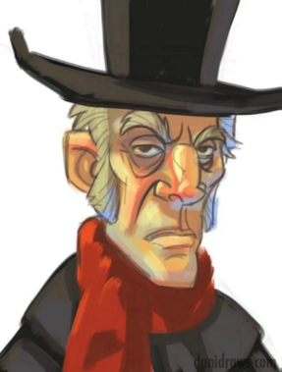
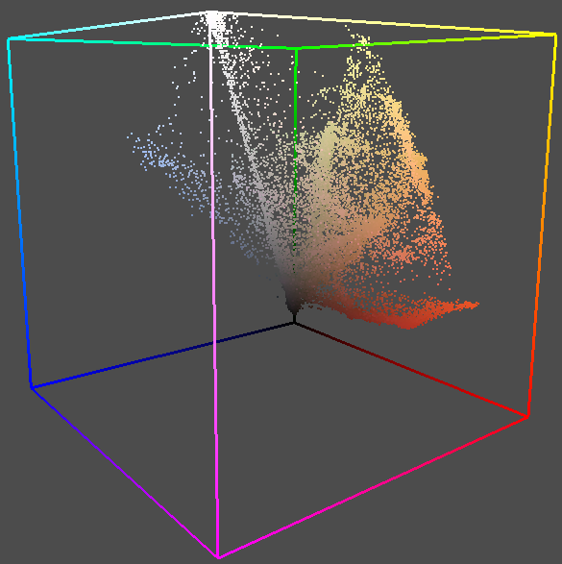
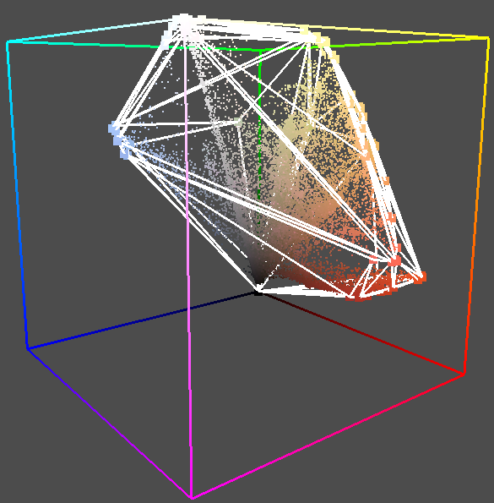
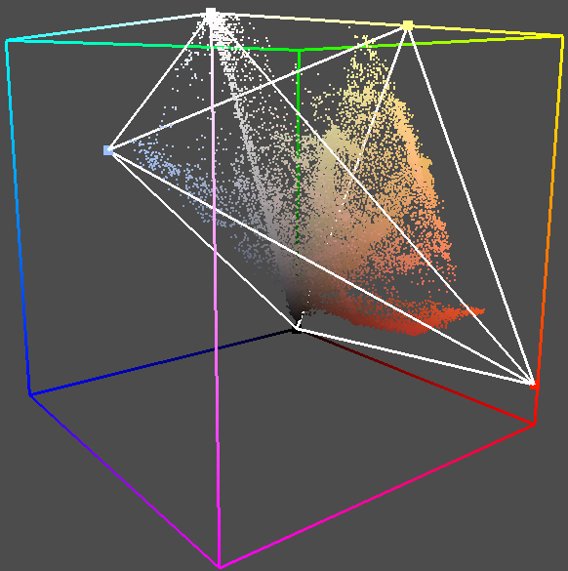
Background
Our work is based on RGB convex hull-based palette recoloring
1) Palette extraction
Input image
RGB point cloud
RGB convex hull
Simplified RGB convex hull
(Palette)
Notes:
Our work is mainly based on geometry-based image recoloring. This method contains two stages: palette extraction and palette-based recoloring.
Geometry-based palette extraction takes an image as input, and projects all image pixels into 3D RGB space, computes its convex hull, and followed by simplification and optimization. The refined convex hull is used as the palette, and its vertices intuitively act as the palette colors.

Slide 6
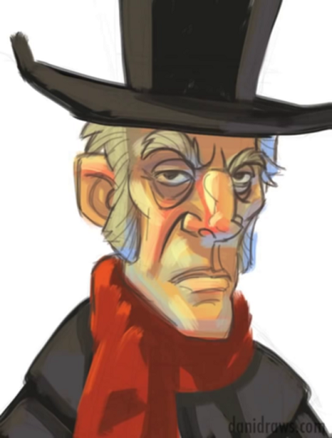
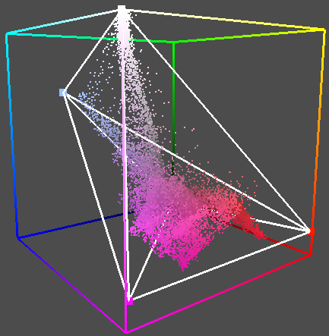
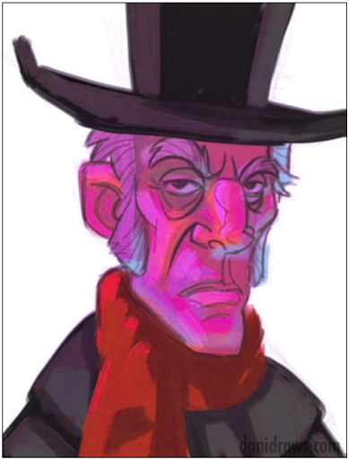

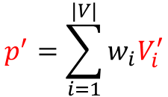

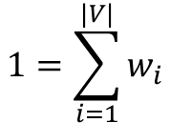

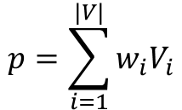

Background
Our work is based on RGB convex hull-based palette recoloring
2) Recoloring
$$p^{′}(r^{′},g^{′},b^{′})$$
$$p(r,g,b)$$
Input image
Palette $V$
Palette ${V }^{′}$
Recolored image
$$p=\sum_{i=1}^{|V|}{w_{i}V_{i}}$$
$$1=\sum_{i=1}^{|V|}{w_{i}}$$
$$p^{′}=\sum_{i=1}^{|V|}{w_{i}V_{i}^{′}}$$
Mixing weights:
Recoloring:
Notes:
Once we obtain the convex hull, each pixel in the image can be expressed as a weighted sum of its palette colors. Keep the mixing weights fixed; when we modify the palette colors, the pixel is then updated accordingly. When we recompute all pixels to the modified palette, it produces a recolored image.

Slide 7
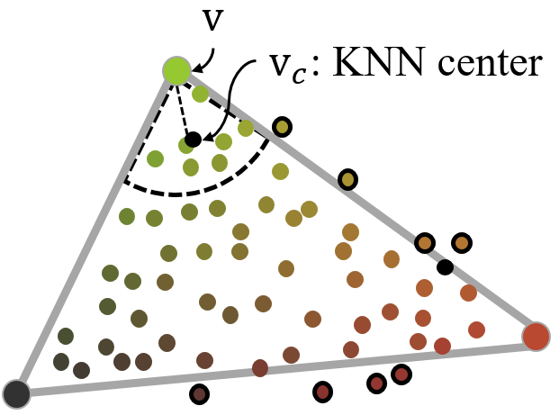
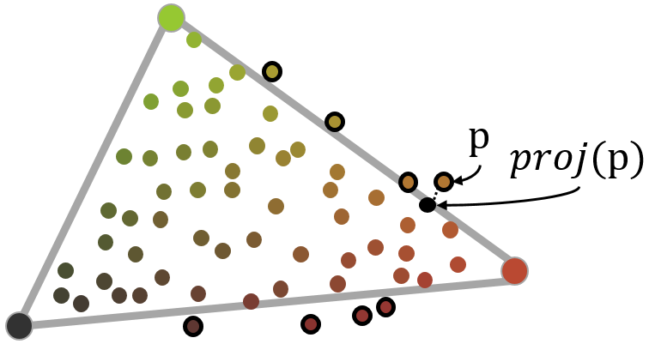
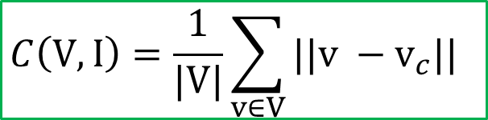
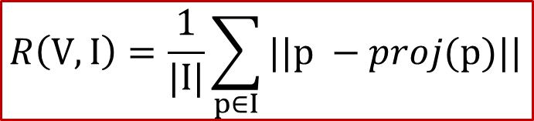
Background
Measurement of the convex hull-based palette $V$
Reconstruction accuracy
Compactness
$$R\left(V,I\right)=\frac{1}{|I|}\sum_{p∈I}{||p −proj(p)||}$$
$$C\left(V,I\right)=\frac{1}{|V|}\sum_{v∈V}{||v −v_{c}||}$$
Notes:
The key of geometry-based image recoloring is to build a simplified convex hull. To get such a convex hull, we take both the reconstruction accuracy and compactness into account.
We measure the reconstruction loss as the average distance of all exterior [ɪkˈstɪəriə(r] pixels to their projection on the convex hull.
and we measure the compactness loss as the average distance of all convex hull vertices to their neighbors' centers.
In general, reconstruction loss enforces the convex hull to enclose as many pixels as possible, and compactness loss enforces the convex hull to wrap the pixels as tight as possible, so that the palette colors are more representative. [ˌreprɪˈzentətɪv]

Slide 8
Background
Measurement of the convex hull-based palette $V$
Reconstruction accuracy
Compactness
$$R\left(V,I\right)=\frac{1}{|I|}\sum_{p∈I}{||p −proj(p)||}$$
$$C\left(V,I\right)=\frac{1}{|V|}\sum_{v∈V}{||v −v_{c}||}$$
$$L\left(V,I\right)=λR\left(V,I\right) + C\left(V,I\right)$$
Image palette overall loss
Notes:
Reconstruction error and compactness are in tension with each other. The overall loss of the palette is defined as their weighted sum, and 𝜆 controls the relative contribution of the two terms.
As a result, the extracted convex hull is with lower reconstruction loss and higher compactness.

Slide 9
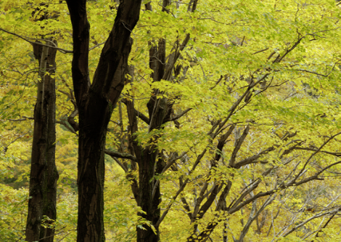
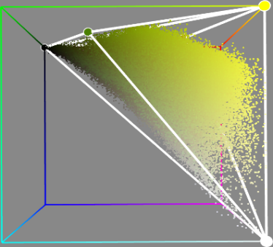



Our main idea
Extend the convex hull-based image recoloring to video scenarios
RGB image
Palette (RGB 3D geometry)
RGBT video
Palette (RGBT 4D geometry)
Notes:
Geometry-based image recoloring employ a 3D RGB convex hull to extract the palette.
Similarly, our main idea is to extend this method to video scenario, and employ a 4D RGBT geometry to extract the video palette.

Slide 10
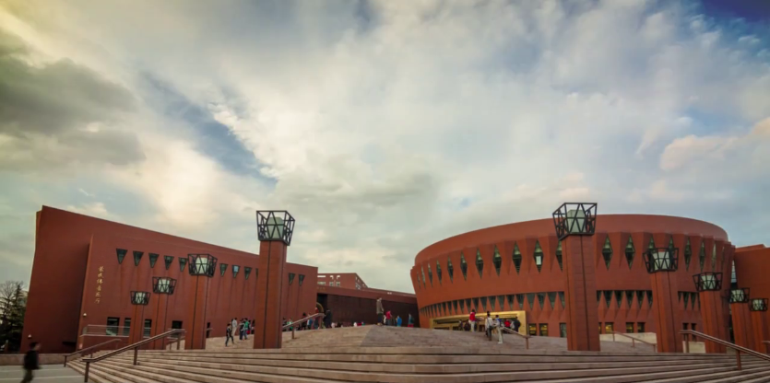
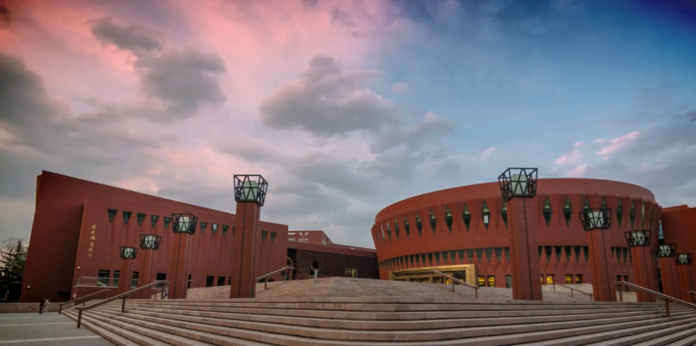
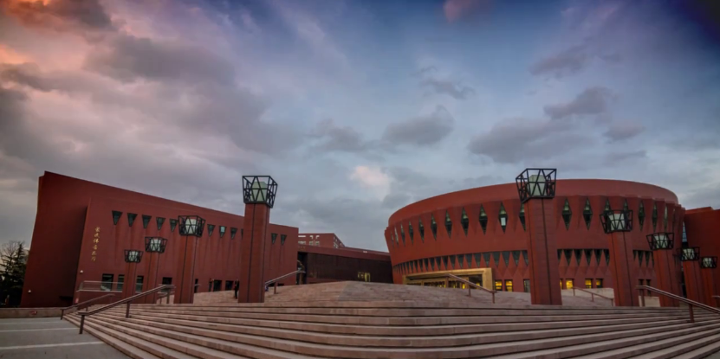
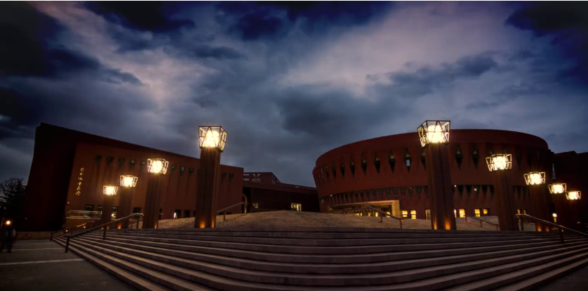
Choices of RGBT 4D geometry
t₀
t₁
t₂
t₃
t
Input video
RGB
space
Poor compactness!
Global RGB convex hull
Notes:
We have four choices to build such a 4D geometry palette in RGBT space.
The 1st approach is to pull a 3D convex hull along temporal dimensional to form a 4D geometry.
But it suffers from poor compactness

Slide 11
Choices of RGBT 4D geometry
t₀
t₁
t₂
t₃
t
Input
video
RGB
space
Poor compactness!
RGBT convex hull
Notes:
The 2nd approach is to build a 4D RGBT convex hull that encloses all video pixels.
It also suffers from poor compactness

Slide 12
Choices of RGBT 4D geometry
t₀
t₁
t₂
t₃
t
Input video
RGB
space
Complex topology!
RGBT regular polytope
Notes:
The 3rd approach is to build a regular 4D RGBT polytope.
Although the RGBT regular polytope looks more compact, its topology is relatively complex.

Slide 13
Choices of RGBT 4D geometry
t₀
t₁
t₂
t₃
t
Input video
RGB
space
Better compactness
Simpler topology
RGBT skew polytope
Notes:
The last approach is to build an RGBT skew polytope.
It should be noted that, unlike with regular polytope, skew polytope allows non-planar [ˈpleɪnə(r)] faces.
Compared with the first three shapes, the skew polytope not only has better compactness, but also has simple topology[tə'pɒlədʒɪ].
Complex topology means many colors split and merge over time, while simpler topology means colors change stably over time.
Therefore, we employ a 4D RGBT skew polytope to extract the video palette.

Slide 14
Choices of RGBT 4D geometry
Global RGB convex hull
RGBT convex hull
RGBT regular polytope
RGBT skew polytope
Notes:
A comparison of these 4d geometry shapes is shown on this page.

Slide 15
Geometric palette measurement
Our loss function
0
1
2
3
t
$$L_{v}\left(P,I\right)=L_{frame}\left(P,I\right)+L_{smooth}\left(P\right)$$
Input video I
Average polyhedral palette loss
Smooth term
Geometric palette P
Notes:
Geometric palette extraction takes a video as input and outputs its geometric palette. Our goal is to
extract a geometric palette with fewer representative colors that accurately reconstruct the video. Meanwhile we expect the polyhedral palettes changes smoothly between adjacent frames.
To measure the quality of the geometric palette, we define the loss function like this. It contains two terms, the first term is the average polyhedral palette loss, and the second is a smooth term.
And a satisfactory video palette can be achieved by minimize the loss function.

Slide 16
Geometric palette measurement
Lower reconstruction loss
$$L_{v}\left(P,I\right)=L_{frame}\left(P,I\right)+L_{smooth}\left(P\right)$$
Polyhedral palettes
Polyhedral palettes
and video pixels
Notes:
Our loss function encourage video palette with lower average polyhedral palette loss
Firstly, for each single frame, we expect the frame pixels can be accurately reconstructed by its corresponding polyhedral palette.
This ensures that there is no artifact in subsequent video recoloring.

Slide 17


Geometric palette measurement
Rewards compactness
$$L_{v}\left(P,I\right)=L_{frame}\left(P,I\right)+L_{smooth}\left(P\right)$$
Polyhedral palettes with larger volumes
Polyhedral palettes with smaller volumes
Notes:
Secondly, we also take the compactness loss into account, Under the compactness constrain[kənˈstreɪn] , our loss function rewards a palette with compact topology [tə'pɒlədʒɪ]. It leads to a video palette with representative colors.
Here, we provide two palettes, our algorithm tends to generate the bottom one with more compact shape that wrap the video pixels tightly.

Slide 18
Geometric palette measurement
Prefers palettes with simpler topologies
$$L_{v}\left(P,I\right)=L_{frame}\left(P,I\right)+L_{smooth}\left(P\right)$$
More vertices and edges
Fewer vertices and edges
Notes:
The palette should remain easy to use, which means it should have a small number of representative colors.
Our algorithm prefer to produce a palette with fewer vertices and simpler topology. It also ensures palette colors changes stably.
Here, we provide two palettes on the right, our algorithm tends to generate the bottom one with fewer vertices and edges.

Slide 19
Geometric palette measurement
Smooth change over time
$$L_{v}\left(P,I\right)=L_{frame}\left(P,I\right)+L_{smooth}\left(P\right)$$
Color changes sharply
Color changes smoothly
Notes:
We also expect the 4D skew polytope to be temporally coherent so that polyhedral palettes change smoothly along the timeline.
So we add a smooth term into the loss function. It sums up the color variation with time on all edges. It helps to generate a video palette with smooth edges.
Here we just briefly introduce the design intent of the loss function. More details please refer to our paper.

Slide 20
Geometric palette extraction
  Step1 Initialization
  Step2 Block Merging
  Step3 Vertex Removal
  Step4 Vertex Refinement
Notes:
As mentioned above, the loss function of the geometric palette is highly non-linear, cannot be easily solved end-to-end, so we propose a progressive approach to extract the video palette.
Generally, the pipeline of the geometric palette extraction contains four stages: initialization, block merging, vertex removal and vertex refinement.
In the following, we give a toy example to show the palette extraction process.

Slide 21
  Step1 Initialization
0
1
2
3
t
Input video
Refined RGB
convex hull
Initial skew
polytope
Notes:
Given an input video, we first extract its simplified convex hull in RGB space and refine it. Next, we glue all these convex hulls together to form an initial skew polytope in RGBT space.

Slide 22
  Step2 Block Merging
0
1
2
3
t
block b1
←
block b2
block b3
block b4
Notes:
In the initialization step, each video frame generated its convex hull independently. As a result, it is likely that the polyhedral palettes of adjacent frames have different topologies[təˈpɒlədʒiz] . We introduce block merging to reduce the unnecessary topological changes between frames. here, a block is defined as a sequence of contiguous frames with consistent topology[təˈpɒlədʒi] .
in this demo, there are 4 blocks in the initial skew polytope. Here block b2 first merges block b1

Slide 23
  Step2 Block Merging
0
1
2
3
t
block b(1,2)
→
block b3
block b4
Notes:
So that frame 1 and frame 2 form a new block b12
And then, block 12 merges block b3

Slide 24
  Step2 Block Merging
0
1
2
3
t
block b(1,2,3)
block b4
Notes:
So that frame 12 and frame 3 form a new block b123

Slide 25
  Step2 Block Merging
0
1
2
3
t
Notes:
After block merging, the 4D skew polytope has simpler topology but still contains a large number of vertices. To further reduce these redundant vertices, we progressively simplify the 4D skew polytope through iterative vertex removal.
In the following, we will show this process step by step.

Slide 26
  Step3 Vertex removal
0
1
2
3
t

Slide 27
  Step3 Vertex removal
0
1
2
3
t

Slide 28
  Step3 Vertex removal
0
1
2
3
t

Slide 29
  Step3 Vertex removal
0
1
2
3
t

Slide 30
  Step3 Vertex removal
0
1
2
3
t

Slide 31
  Step3 Vertex removal
0
1
2
3
t

Slide 32
  Step3 Vertex removal
0
1
2
3
t

Slide 33
  Step3 Vertex removal
0
1
2
3
t

Slide 34
  Step4 Vertex refinement
0
1
2
3
t
Notes:
After simplifying the 4D skew polytope, we perform additional vertex refinement to further reduce the overall video loss and increase the smoothness of edges in the skew polytope.

Slide 35
  Step4 Vertex refinement
0
1
2
3
t
Notes:
We employ an iterative [ˈɪtəˌreɪtɪv] scheme to refine the simplified skew polytope. Specifically [spəˈsɪfɪkli] , at each iteration, we select one vertex for local adjustment and keep all other vertices fixed.
We cycle through all vertices several times for the above iterative refinement process until convergence.
In the following, we will this process step by step.

Slide 36
  Step4 Vertex refinement
0
1
2
3
t

Slide 37
  Step4 Vertex refinement
0
1
2
3
t

Slide 38
  Step4 Vertex refinement
0
1
2
3
t

Slide 39
  Step4 Vertex refinement
0
1
2
3
t

Slide 40
  Step4 Vertex refinement
0
1
2
3
t

Slide 41
  Step4 Vertex refinement
0
1
2
3
t

Slide 42
  Step4 Vertex refinement
0
1
2
3
t

Slide 43
  Step4 Vertex refinement
0
1
2
3
t

Slide 44
Output the geometric palette
0
1
2
3
t
Refined
skew polytope
Geometric
palette
Notes:
The resulted 4D skew polytope corresponds to the generated geometric palette.
So far, we have already extracted the geometry palette from a given video, next we show how to use it to recolor the video.

Slide 45
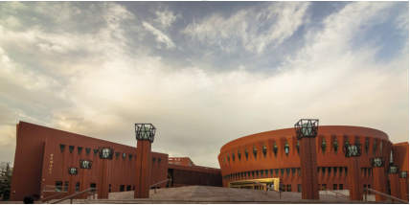

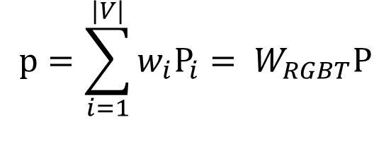


Video recoloring
0
t
N-1
t
Geometric palette P
$$p(r,g,b,t)$$
Frame t
$${p=\sum_{i=1}^{|V|}{w_{i}P_{i}}= W}_{RGBT}P$$
T
$${= W}_{RGBT}$$
Geometric palette P vertices (colors)
Notes:
In a video, any pixel p with color(r,g,b) in frame t can be regarded as a point p(r,g,b,t) in RGBT space.
Similar to image recoloring, Our goal is to express p as a linear combination of the geometric palette vertices.
But how to compute the mixing weights matrix?

Slide 46







Video recoloring
0
t
N-1
t
$$P_{j}$$
$$V_{t}^{i}$$
$$P_{k}$$
$$V_{t}$$
Geometric palette P
$$p(r,g,b,t)$$
Frame t
1) Get the slice (polyhedral palette) at frame $t$:
$$V_{t}=S\left(P,t\right)$$
Each vertex of $V_{t}$ lies in an edge of P, it can be linearly interpolated as:
$$V_{t}^{i}=αP_{j}+(1−α)P_{k}$$
$V_{t}$ $=$ $W_{t}P$
Notes:
Firstly, we slice the skew polytope at time t to get the polyhedral palette v_t that encloses p.
since each vertex of the slice V_t lies in an edge of the skew polytope of P, so the vertices of the polyhedral palette can be calculated by linear interpolation.
so the vertices of the polyhedral palette can be further expressed as matrix form: V_t = W_tP

Slide 47
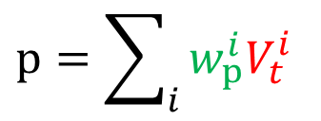






Video recoloring
0
t
N-1
t
$$V_{t}^{0}$$
$$V_{t}^{3}$$
$$V_{t}^{1}$$
$$V_{t}^{2}$$
$$V_{t}$$
$$V_{t}$$
Geometric palette P
$$p(r,g,b,t)$$
2) Inside the slice (closed polyhedron $V_{t}$), the point p can be expressed as:
$$p=\sum_{i}{w_{p}^{i}V_{t}^{i}}$$
$$p=W_{p}V_{t}$$
Mean value coordinates for closed triangular meshes [Ju et al. 2005]
Notes:
Secondly, any vertex inside V_t can be expressed as a linear combination of V_t's vertices.
In this paper, we use Mean value coordinates to compute the mixing weights.
And other generalized barycenteric coordinates are also available for this task.

Slide 48
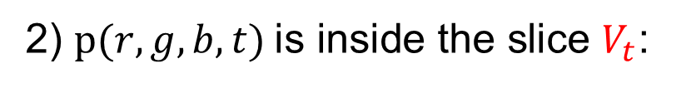

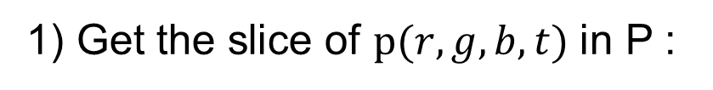
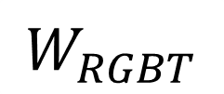
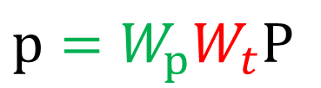

Video recoloring
0
t
N-1
t
$$V_{t}^{0}$$
$$V_{t}^{3}$$
$$V_{t}^{1}$$
$$V_{t}^{2}$$
$$V_{t}$$
$$V_{t}$$
Geometric palette P
$$p(r,g,b,t)$$
1) Get the slice of $p(r,g,b,t)$in P :
$$V_{t}= W_{t}P$$
$$p=W_{p}W_{t}P$$
2) $p(r,g,b,t)$is inside the slice $V_{t}$:
$$p=W_{p}V_{t}$$
$$W_{RGBT}$$
Notes:
Since both steps are linear, they can be combined through matrix multiplication. In this way, any point p(r,g,b,t) can be directly expressed as linear combination of the 4D geometric palette.

Slide 49

Video recoloring
0
t
N-1
t
Geometric palette P
$$p(r,g,b,t)$$
Frame t
$$p=W_{RGBT}P$$
Notes:
Keep the weight matrix fixed, when we modify the geometric palette, all video pixels are updated accordingly, and resulting a recolored video.

Slide 50
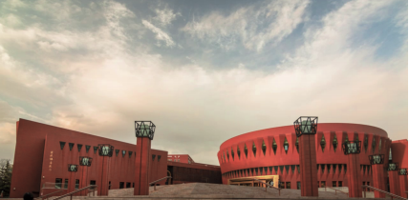



Video recoloring
0
t
N-1
t
Geometric palette $P^{′}$
$$p^{′}(r^{′},g^{′},b^{′},t)$$
Recolored frame t
$$p=W_{RGBT}P$$
$$p^{′}=W_{RGBT}P^{′}$$
Notes:
Keep the weight matrix fixed, when we modify the geometric palette, all video pixels are updated accordingly, and resulting a recolored video.

Slide 51
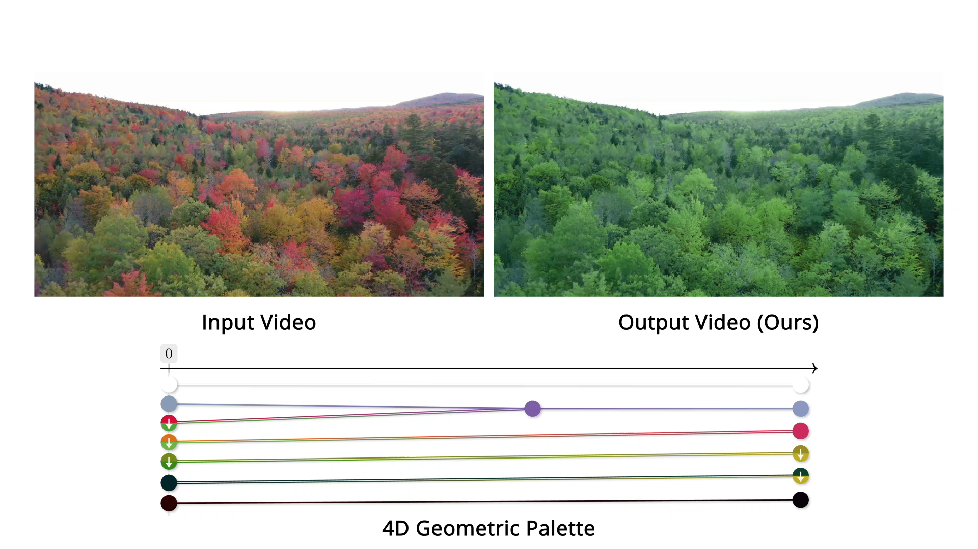
Results
Notes:
Here we show some video recoloring results.
In this video, we make the mountain gradually change from spring to autumn.

Slide 52
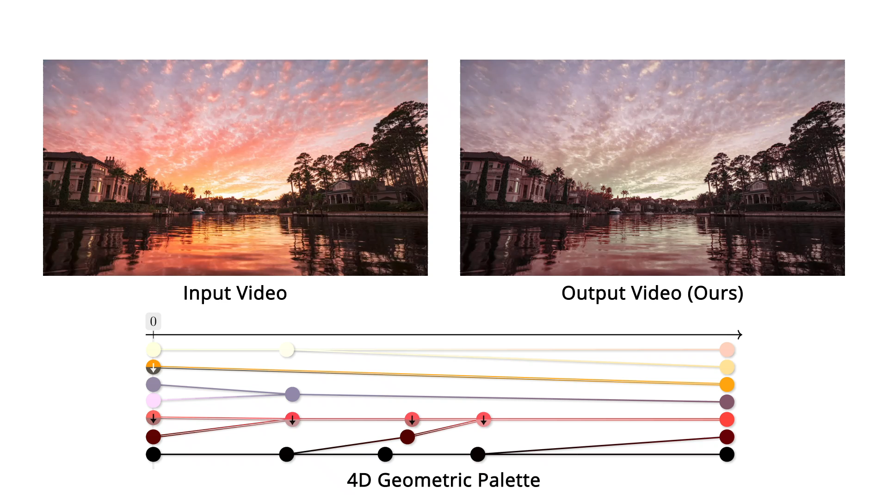
Results
Notes:
In this video, we make the cloud color changes from gray to red.

Slide 53
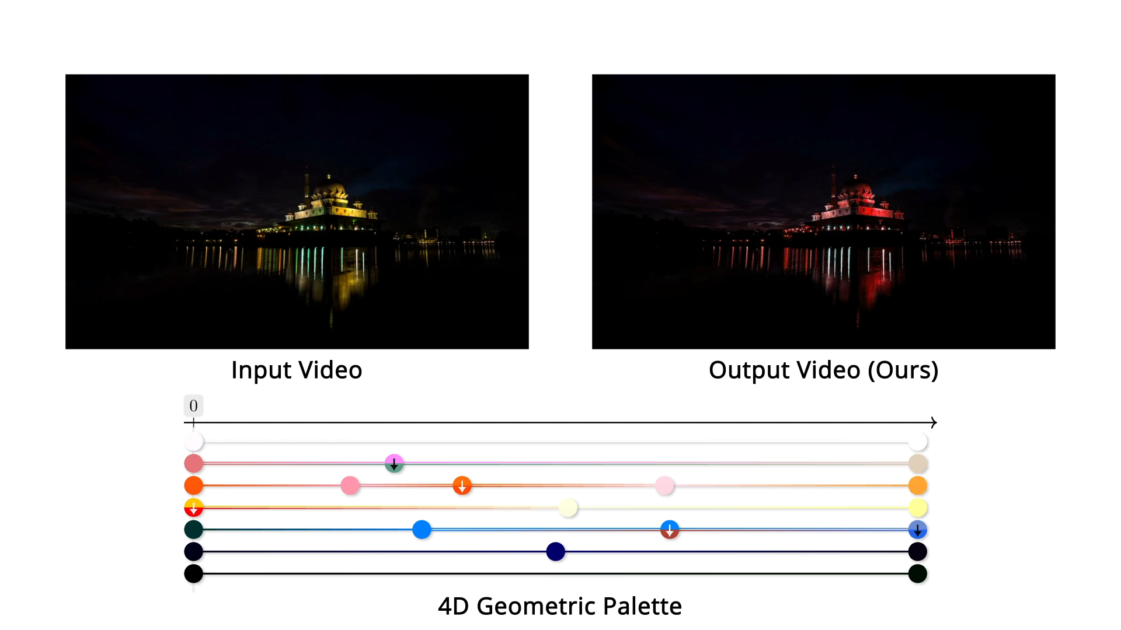
Results
Notes:
In this video, we perform more color variations to the cloud and the mosque to make them more colorful.

Slide 54
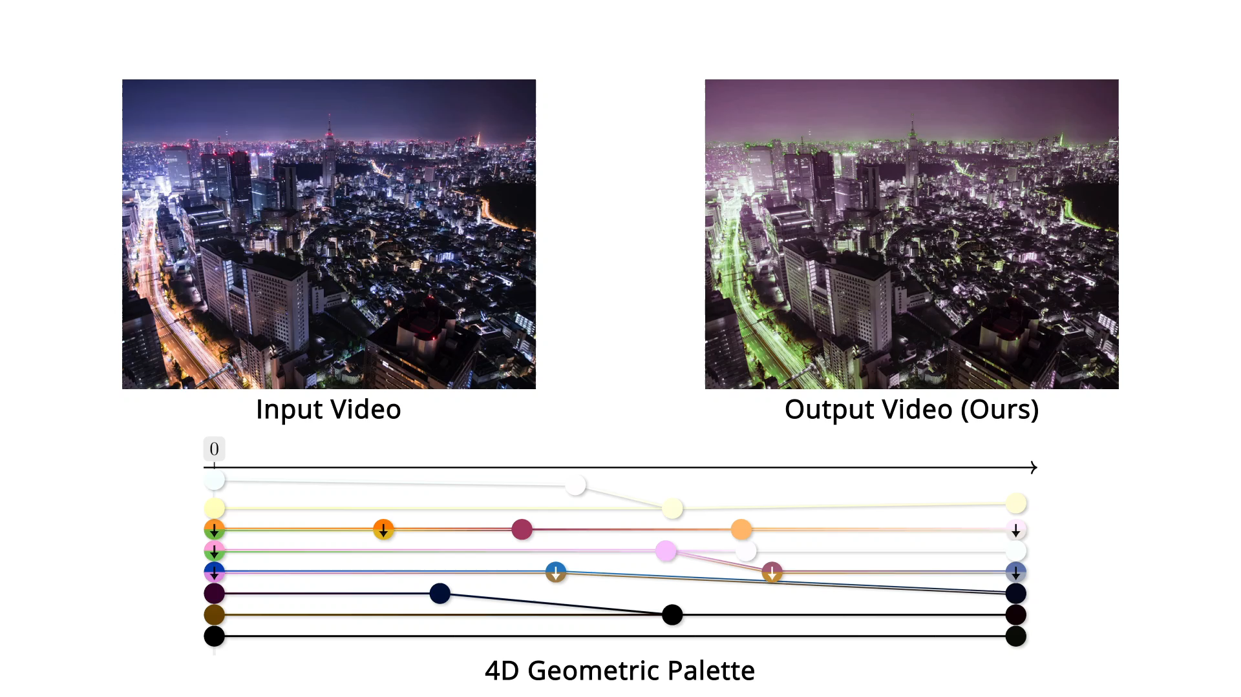
Results
Notes:
In this video, we make the light color gradually changes from green to yellow, and the morning looks warmer.

Slide 55
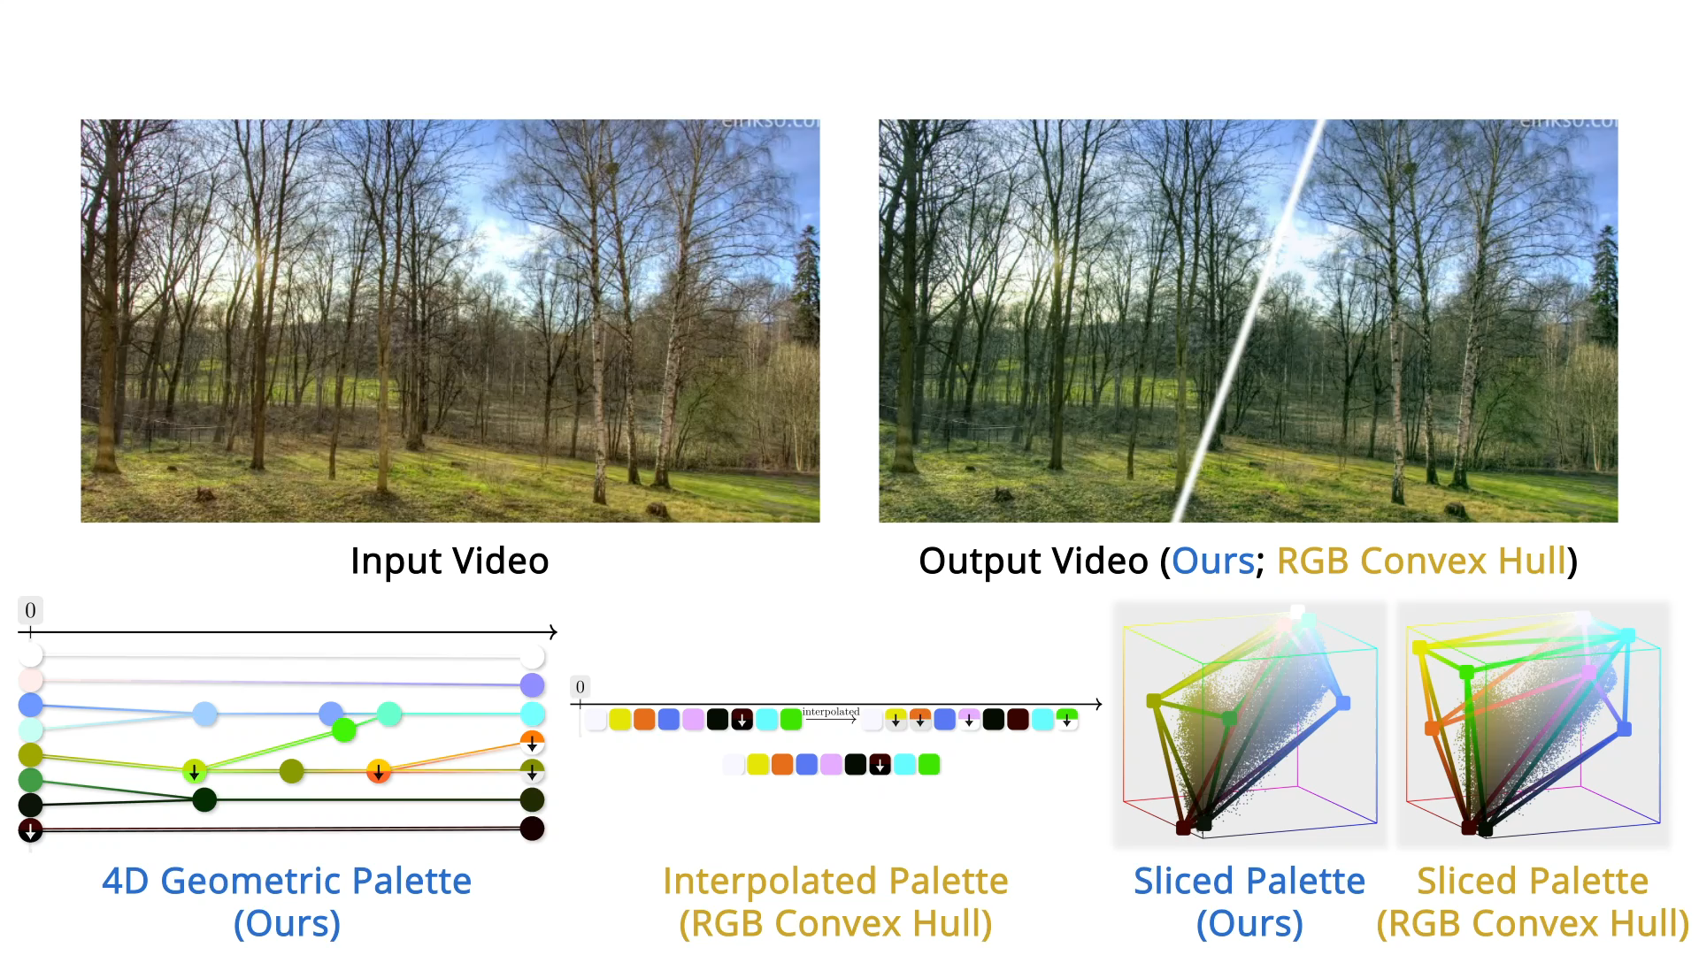
Compare to RGB convex hull
Notes:
Here, we compared our method with global RGB convex hull-based method. in this video, The recoloring intent is to emphasize the change in seasons by making the earth darker in spring, the leaves greener in summer and redder in autumn, and the fallen leaves whiter in winter. Our palette captures object color changes in the video, and achieve natural time-varying effects. While RGB convex hull-based method fails to capture the colors change.

Slide 56
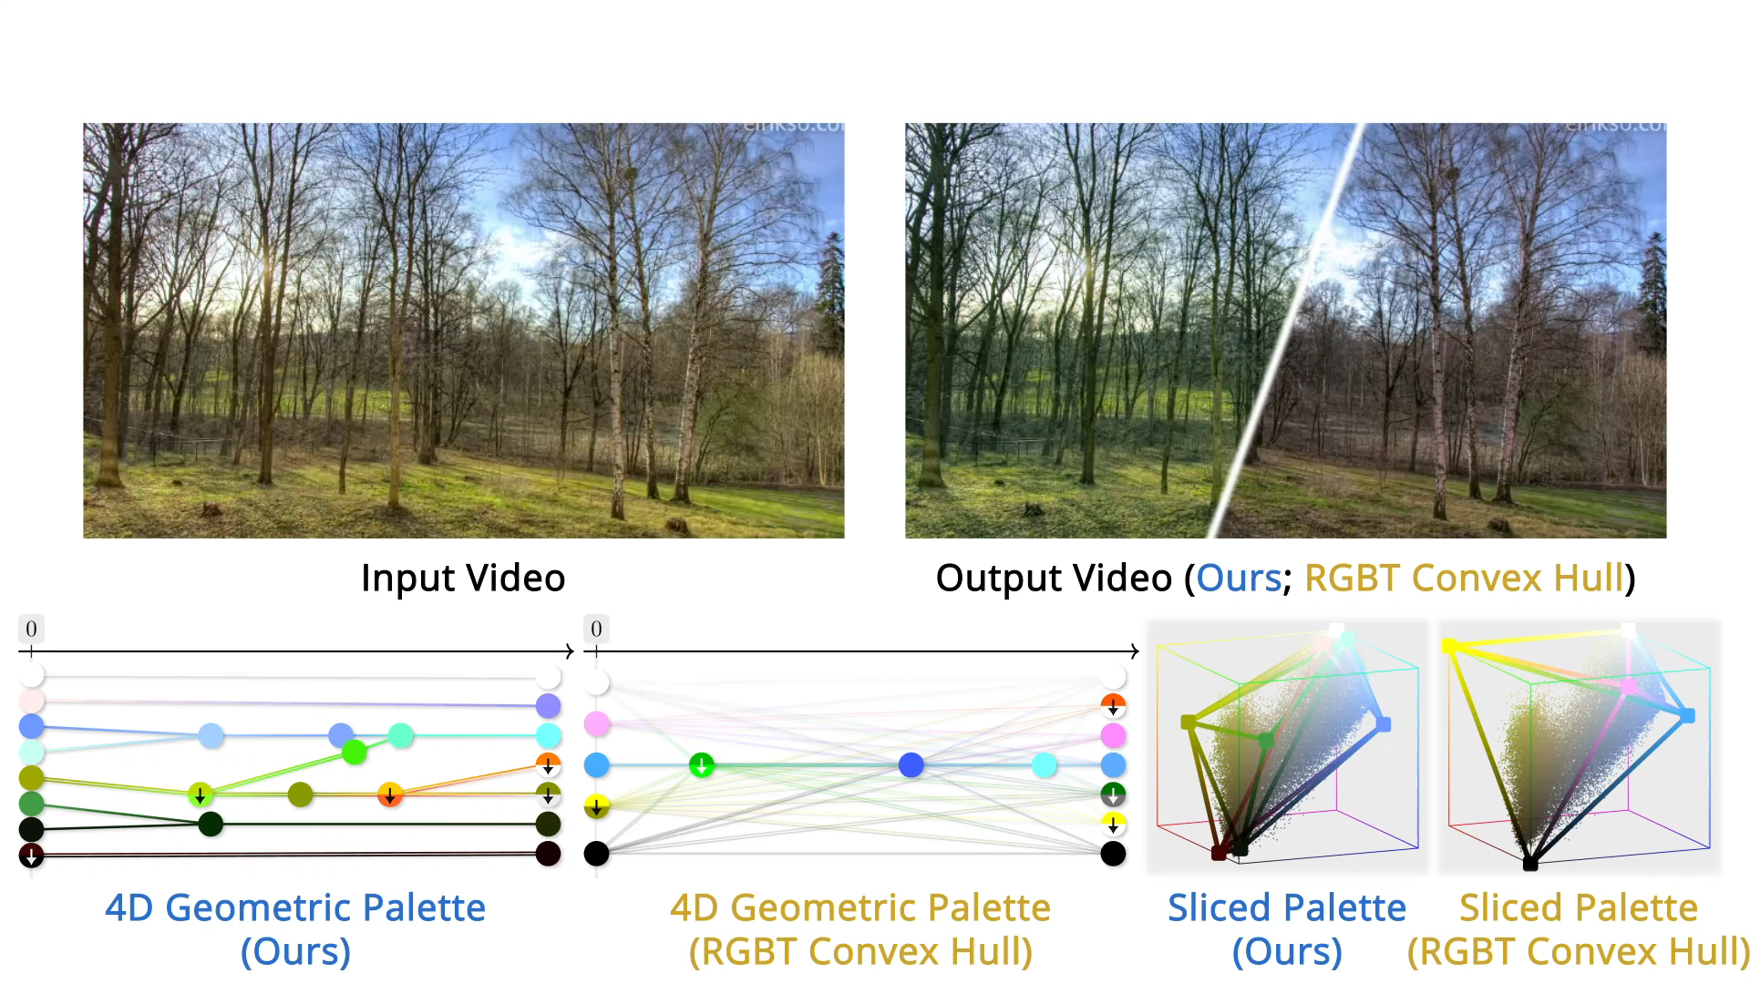
Compare to RGBT convex hull
Notes:
Here, we compared our method with global RGBT convex hull-based method. It is clear that the RGBT convex hull-based palette with complexity topology, suffer from poor compactness and fails to recolor the video as expected.

Slide 57
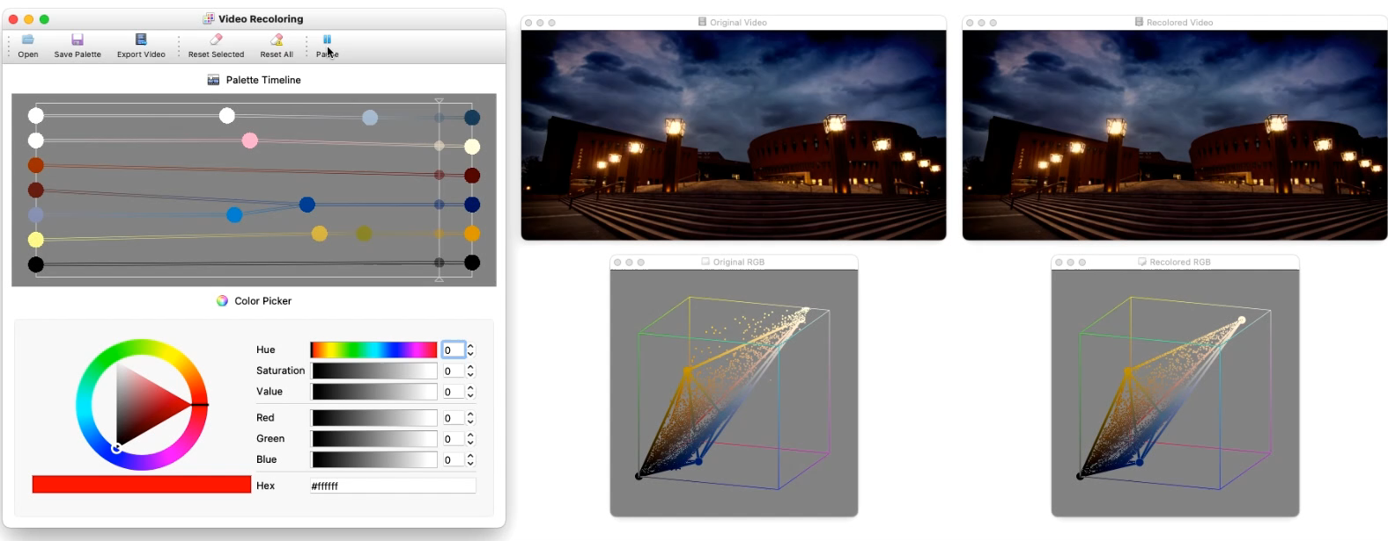
Conclusion
We proposed the first palette-based video recoloring
Our method produces natural, artifact-free recoloring
Notes:
In conclusion, we propose the first palette-based video recoloring, and our method produces natural, artifact-free recoloring.

Slide 58
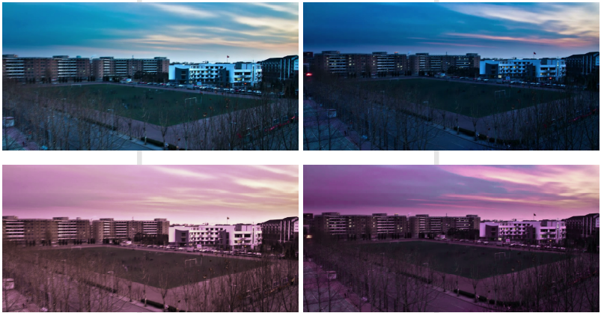
Limitation
Can not realize object aware local recoloring
The sky and building with similar blue
Input video
Recolored
video
Different objects with similar colors will be recolored simultaneously
Notes:
The first limitation of our method is that palette-based editing methods perform global recoloring, so some spatially-varying or per-object changes cannot be captured without additional semantic information.

Slide 59


Limitation
Non-linear color editing such as tone mapping is not supported
0
t
N-1
t
The 4D geometric palette P
$$p(r,g,b,t)$$
Frame t
$$p=W_{RGBT}P$$
Notes:
Secondly, our method is able to support a range of useful color manipulations, but linear-mixing-weight-based approaches cannot handle non-linear color manipulations such as tone mapping.

Slide 60

Thank You!
Contact Information:
  Zheng-Jun Du: duzj19@mails.tsinghua.edu.cn
  Kai-Xiang Lei: leikx18@mails.tsinghua.edu.cn
  Kun Xu: xukun@tsinghua.edu.cn
  Jianchao Tan: tanjianchaoustc@gmail.com
  Yotam Gingold: ygingold@gmu.edu
Project page
Notes:
That's all my presentation.
Thanks for your attention!
If you have any questions, please feel free to contact us.

